Slide 1

Prompt Engineering & In-Context Learning
Programming with English: From "Magic Words" to Robust Systems
Notes:
"Stop Guessing, Start Engineering: The Shift from Art to System."

Slide 2
The New Paradigm
Notes:
English is the hottest programming language. High level Programming is mostly an abstraction from assembly language.
Abstractions lead to object-oriented programming and functional programming etc in the past.

Slide 3
The Mental Shift (2023 vs. 2025)
2023 Mindset (The "Whisperer"): "If I ask politely and use the word 'please', the AI works better." (Subjective, fragile).
2025 Mindset (The Engineer): "I need to optimize the context window, structure the output schema (JSON/XML), and evaluate reliability." (Objective, robust).
Key Concept: In-Context Learning. The model isn't "learning" permanently (like fine-tuning); it is "learning" temporarily from the data you put in the prompt.

Slide 4
Prompt Engineering is "Soft Programming"
Analogy:
Variables = The Context (Documents, User History).
Functions = The Instructions ("Summarize this", "Extract entities").
Return Type = The Output Format (JSON, List, Markdown).
The Code: In standard programming, you write function(x). In Prompt Engineering, you write:
"You are a function that takes 'x' and returns 'y'. Do not output anything else."

Slide 5
The 4 Components of a Perfect Prompt (there are many actually)
Role/Persona: "You are a Senior Robotics Engineer..." (Sets the latent space).
Instruction: "Analyze the following log file..." (The core task).
Context/Constraint: "Use only the data provided below. Output in valid JSON." (Guardrails)
Few-Shot Examples: "Here is an example of a good input and output..." (The gold standard).
Notes:
promptingguide.ai

Slide 6
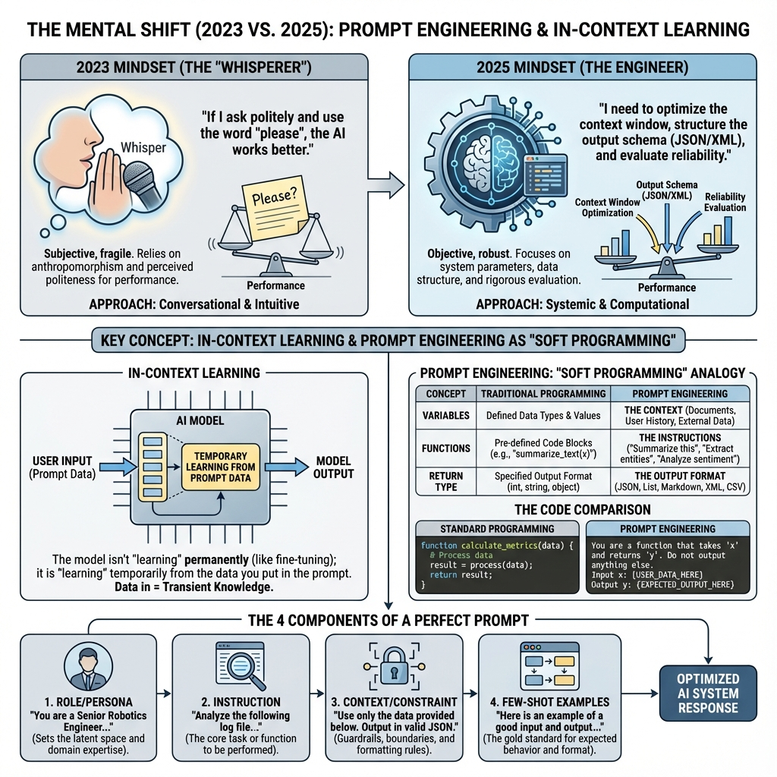

Slide 7

Core Techniques

Slide 8
Level 1: Zero-Shot vs. Few-Shot
Zero-Shot: Asking blindly.
Input: "Classify this review: 'The battery died in 5 minutes.'" -> Output: "Negative."
Few-Shot (In-Context Learning): Giving examples to set the pattern.
Input: "Review: 'Great motor.' -> Label: Hardware_Positive" "Review: 'Software crashed.' -> Label: Software_Negative" "Review: 'The battery died.' -> Label: ?"
Why it wins: It teaches the format and the nuance instantly without training.

Slide 9
Level 2: Chain-of-Thought (CoT)
The Breakthrough: LLMs are bad at math/logic if they answer immediately. They need "thinking time."
The Technique: Force the model to generate intermediate steps.
Standard Prompt: "How many wheels do 3 cars and 2 bikes have?" -> Model might guess.
CoT Prompt: "Think step-by-step. First count car wheels, then bike wheels, then sum them."
Step 1: 3 cars * 4 = 12.
Step 2: 2 bikes * 2 = 4.
Step 3: 12 + 4 = 16.

Slide 10
Level 3: Tree-of-Thoughts & Self-Consistency
Advanced Reasoning (2025 Standard):
Self-Consistency: Ask the same question 5 times. If 4 answers are "A" and 1 is "B", pick "A".
Tree-of-Thoughts: Ask the model to generate three possible plans, critique each one, and pick the best path before solving.
Robotics Use Case: "Plan a path for the robot. Path A is short but rocky. Path B is long but smooth. Evaluate risks of both."

Slide 11
Level 4: Structured Output (JSON Mode)
The Problem: You can't code with "Sure! Here is the list..."
The Fix: Enforcing Schemas.
Prompt: "Output strictly in JSON format matching this schema: { 'sentiment': float, 'entities': list }."
Why: This allows you to plug the LLM directly into Python code (json.loads(response)).

Slide 12
"Context Engineering" (The Window)
The "Needle in a Haystack" Problem: Putting important info in the middle of a long prompt often gets lost.
Best Practice:
System Instructions (Start).
Context/Data (Middle).
Specific Task/Question (End - "Recency Bias" helps here).

Slide 13
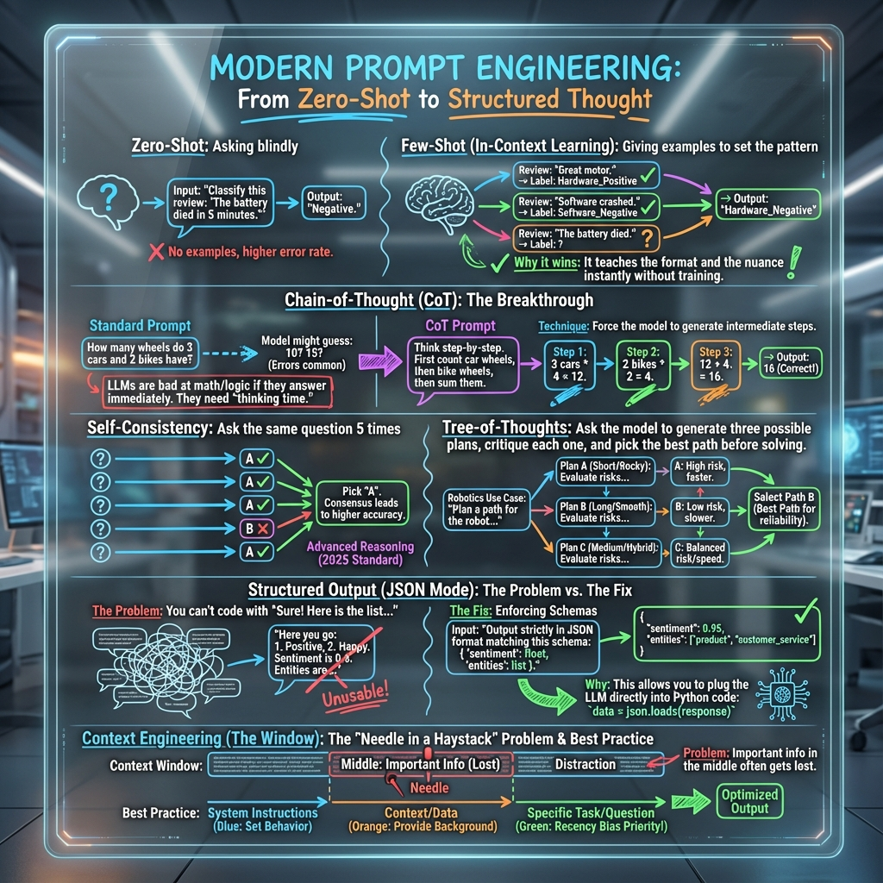

Slide 14
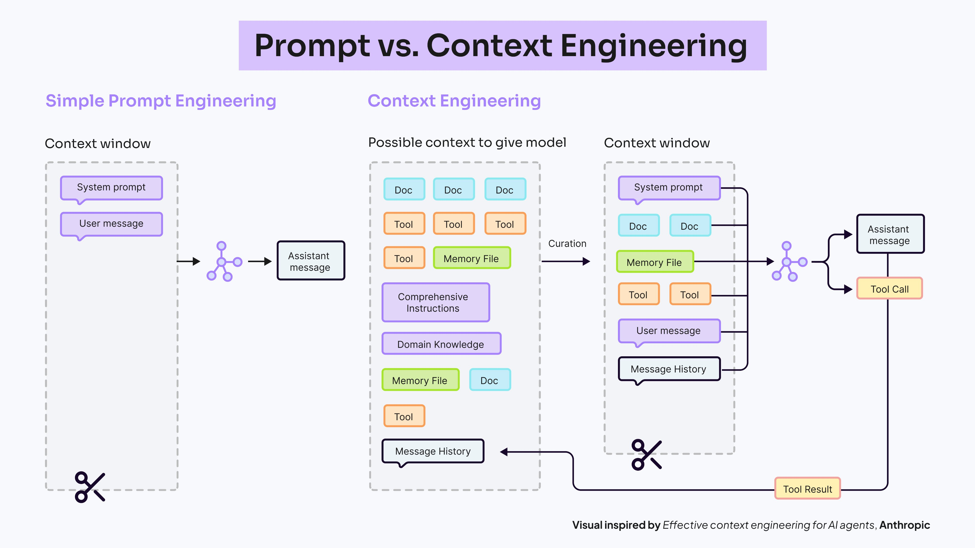
https://x.com/femke_plantinga/status/1993666171447513571/photo/1
Notes:
Real-world LLM systems need both prompt and context engineering. But what is the actual difference between them?
𝗣𝗿𝗼𝗺𝗽𝘁 𝗘𝗻𝗴𝗶𝗻𝗲𝗲𝗿𝗶𝗻𝗴: Prompt engineering is about 𝗵𝗼𝘄 𝘆𝗼𝘂 𝗽𝗵𝗿𝗮𝘀𝗲 𝗶𝗻𝘀𝘁𝗿𝘂𝗰𝘁𝗶𝗼𝗻𝘀 for the LLM. It's the practice of designing and optimizing the actual questions, commands, and examples you give to the model to get your desired output.
Think of techniques like:
• Chain of Thought (asking the model to "think step-by-step")
• Few-shot learning (providing examples to guide responses)
• Tree of Thoughts (exploring multiple reasoning paths)
Example: Creating a prompt that says "Analyze this document step-by-step, first identifying key themes, then extracting specific data points" is prompt engineering.
𝗖𝗼𝗻𝘁𝗲𝘅𝘁 𝗘𝗻𝗴𝗶𝗻𝗲𝗲𝗿𝗶𝗻𝗴: Context engineering is about 𝘀𝘁𝗿𝘂𝗰𝘁𝘂𝗿𝗶𝗻𝗴 𝘄𝗵𝗮𝘁 𝗶𝗻𝗳𝗼𝗿𝗺𝗮𝘁𝗶𝗼𝗻 𝗿𝗲𝗮𝗰𝗵𝗲𝘀 𝘁𝗵𝗲 𝗺𝗼𝗱𝗲𝗹 and when. It's the discipline of designing systems that feed an LLM the right data at the right time - building the bridges that connect it to external knowledge, tools, and memory.
This includes:
• Retrieval systems (RAG) that pull relevant documents
• Memory management for conversation history
• Tool orchestration for accessing external APIs
• Chunking strategies for processing large documents
Example: Building a system that retrieves the top 5 most relevant documents based on semantic similarity, then managing how that context fits within the model's token limits - that's context engineering.
𝗧𝗵𝗲 𝗞𝗲𝘆 𝗗𝗶𝗳𝗳𝗲𝗿𝗲𝗻𝗰𝗲 Prompt engineering = What you 𝘀𝗮𝘆 to the model Context engineering = What you 𝗽𝗿𝗼𝘃𝗶𝗱𝗲 to the model But they work together. The most sophisticated prompting techniques (CoT, ReAct, ToT) are most effective when combined with well-engineered context. You can craft the perfect prompt, but if you're feeding the model irrelevant or poorly structured information, you won't get reliable results.
𝗪𝗵𝘆 𝗕𝗼𝘁𝗵 𝗠𝗮𝘁𝘁𝗲𝗿 A production-ready LLM application needs both:
• 𝗣𝗿𝗼𝗺𝗽𝘁 𝗲𝗻𝗴𝗶𝗻𝗲𝗲𝗿𝗶𝗻𝗴 ensures the model interprets and responds to instructions correctly
• 𝗖𝗼𝗻𝘁𝗲𝘅𝘁 𝗲𝗻𝗴𝗶𝗻𝗲𝗲𝗿𝗶𝗻𝗴 ensures the model has access to the right information and tools to generate factual, relevant responses Without context engineering, even the best prompts can't overcome the model's knowledge limitations. Without prompt engineering, even the best context won't be used effectively.

Slide 15
The Frontier – DSPy & Programming

Slide 16
"Don't Write Prompts, Compile Them"
Introduction to DSPy (Declarative Self-Improving Python): A Stanford framework that is replacing manual prompt engineering.
The Concept:
You define the Goal: "Answer questions based on context."
You define the Metric: "Answer must match the fact sheet."
DSPy Optimizes the Prompt: It acts like a compiler. It tries 50 different variations of the prompt to see which one gets the highest score, then saves the best one.

Slide 17
System 2 Reasoning Models
New in 2025: Models that automatically do Chain-of-Thought without you asking. OpenAI – “o’ models, GPT5, GPT-5.1, Google Gemini3, Claude-Sonnet-4-5, Claude-Opus-4-5, DeepSeek, Kimi-Max and many more.
Implication: For these models, "simple" prompts are often better. The model manages its own thinking process.

Slide 18
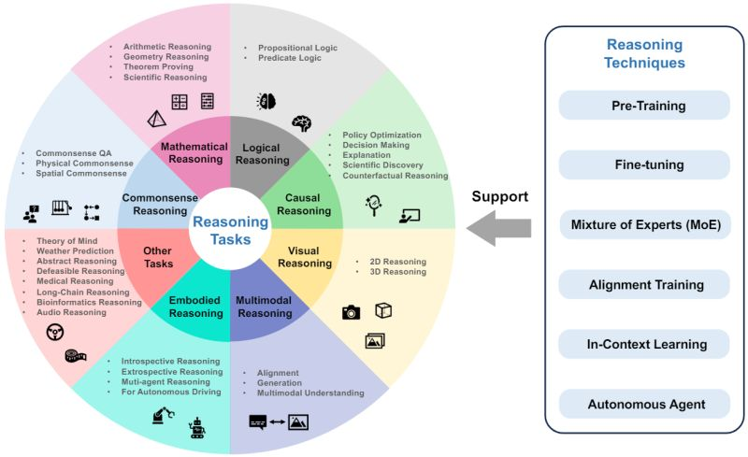
https://arxiv.org/abs/2303.18223

Slide 19
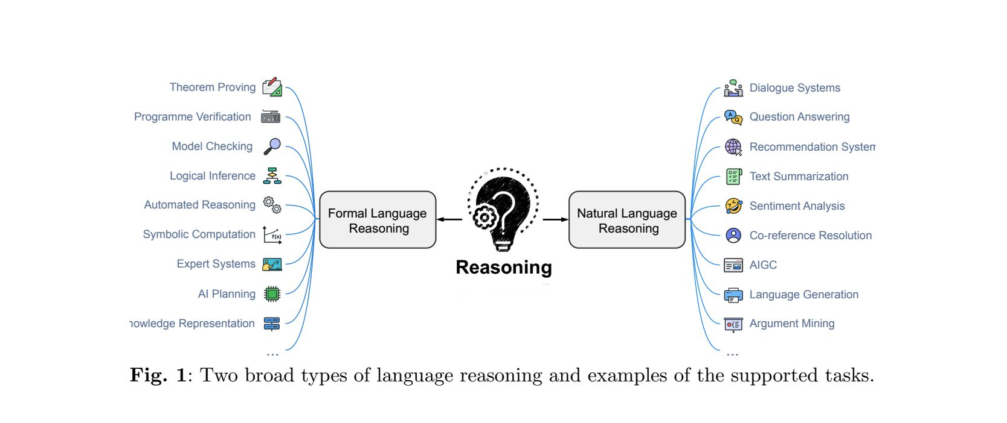
https://arxiv.org/abs/2303.18223

Slide 20
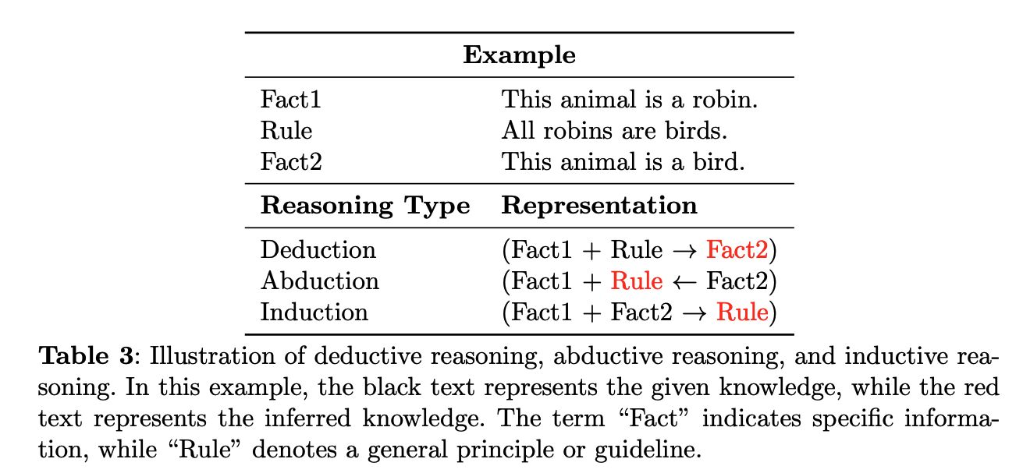
https://arxiv.org/abs/2303.18223

Slide 21
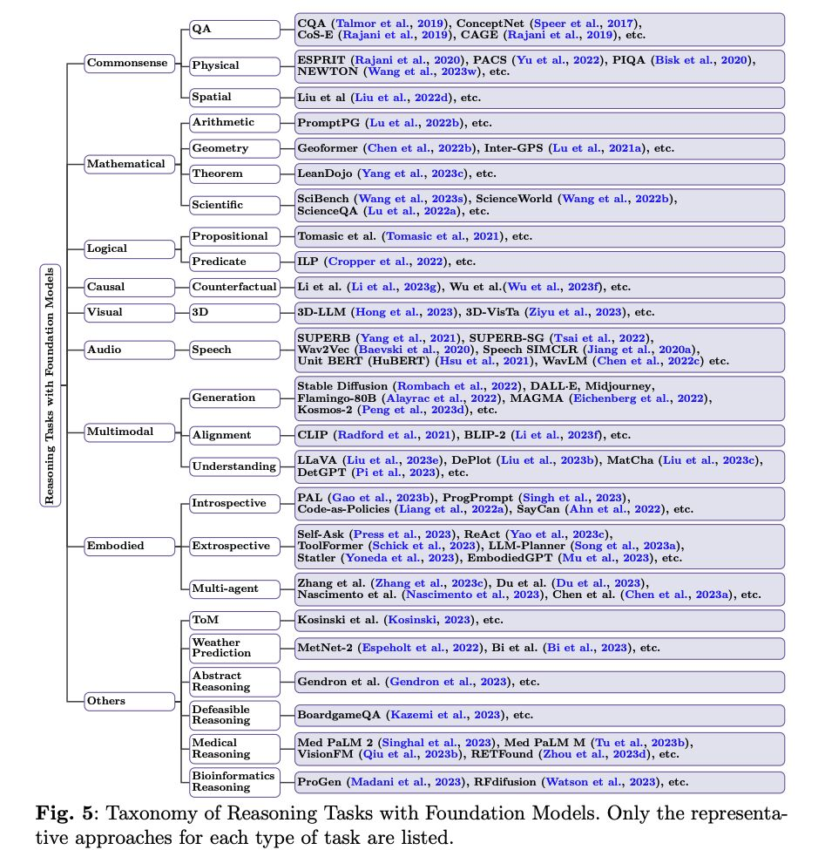
https://arxiv.org/abs/2303.18223
Notes:
https://github.com/RUCAIBox/LLMSurvey

Slide 22
Lab

Slide 23
Prompting & LLM as a Judge
Prompt Battle (LMArena or any other provider)
LLM as a Judge
The Mission: You have a dataset of 50 "tricky" customer service emails (sarcasm, mixed languages, subtle complaints) or any other dataset. Note: HuggingFace datasets.
The Goal: Extract the Core Issue and Sentiment with 100% accuracy.
The Constraint: You cannot change the model (e.g., Llama 3.2 or GPT-5-mini). You can only change the Prompt. [ Use your own LLM model]
How we grade: We won't grade manually. We will use LLM as the "Judge."
The Rubric (Code Provided):
Correctness (1-5): Did it identify the right product?
Format (Pass/Fail): Is it valid JSON?
Reasoning: Did it explain why?
Why this matters: This is how industry evaluates AI systems at scale

